Slide 1
ENG1003 Freshman Seminar for Engineering AAE Design of Path Planning Algorithm for Aircraft Operation Week 3: Introduction to Path Planning, Python and GitHub
Dr Li-Ta Hsu
Assisted by Dr Weisong Wen

Slide 2
Teaching Assistant Information
Instructor: Dr Weisong WEN
Office: PQ408
Phone: 3400-8234
Email: welson.wen@polyu.edu.hk
Office Hour: by appointment
Expertise: Autonomous driving, Navigation, Sensor Integration

Slide 3
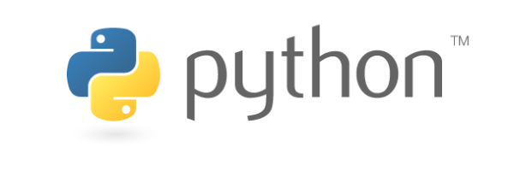

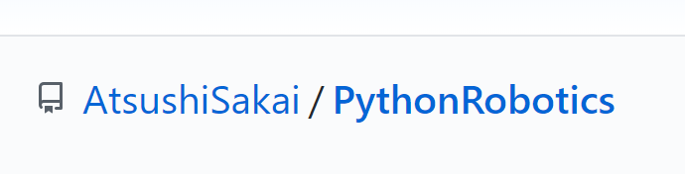
What you are expected to learn?
Academic level of algorithm designs
Design of a path planning algorithm
2D path planning for simplicity
Make use of the open-resource to work on coding-project remotely.
Programming and coding
Python
Online coding collaboration
GitHub

Slide 4
Install Python and Debugger Visual Studio Code in Win10

Slide 5
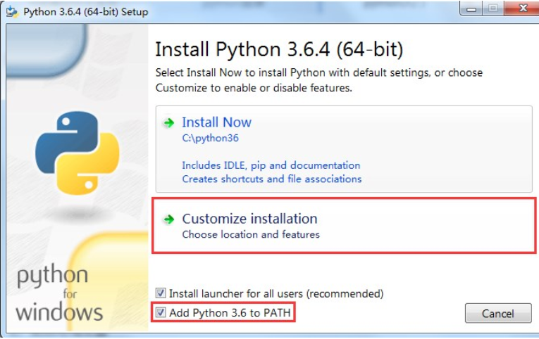
Install Python in Windows 10
Step 1: Download Python 3.6.4 https://www.python.org/ftp/python/3.6.4/python-3.6.4-amd64.exe
Step 2: Install Python 3.6.4 in Windows 10
Python is an interpreted, high-level, general-purpose programming language. Created by Guido van Rossum and first released in 1991, Python's design philosophy emphasizes code readability with its notable use of significant whitespace.

Slide 6
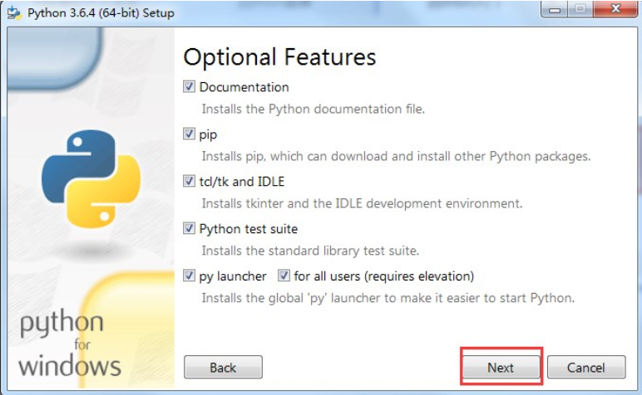
Install Python in Windows 10

Slide 7
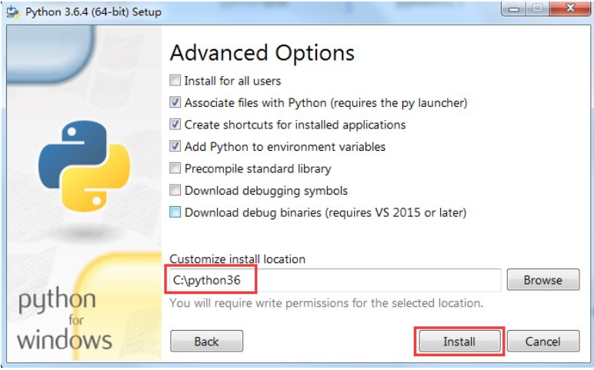
Install Python in Windows 10

Slide 8
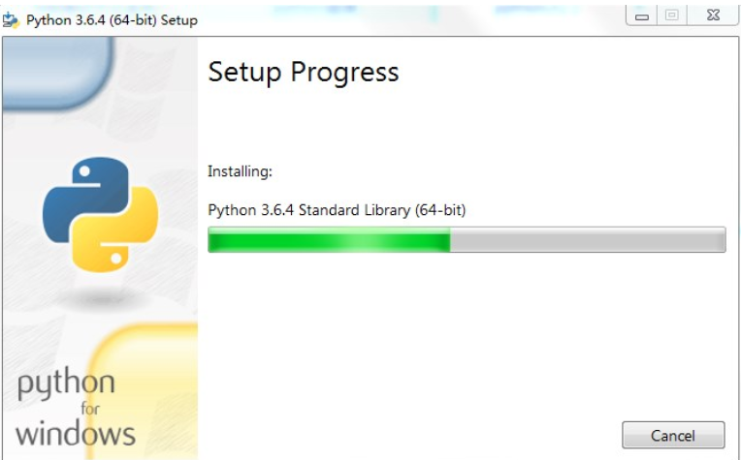
Install Python in Windows 10

Slide 9
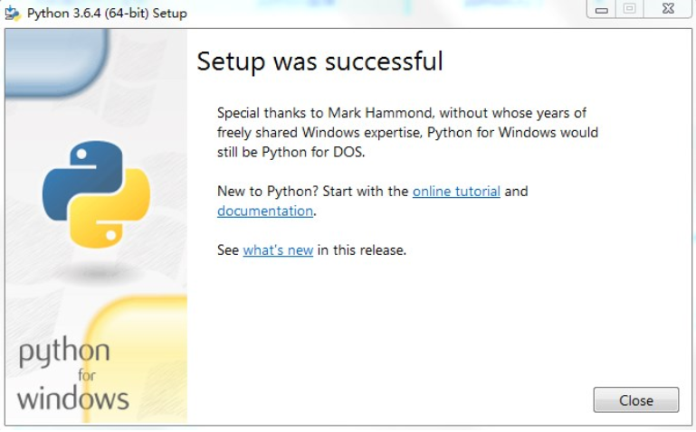
Install Python in Windows 10

Slide 10
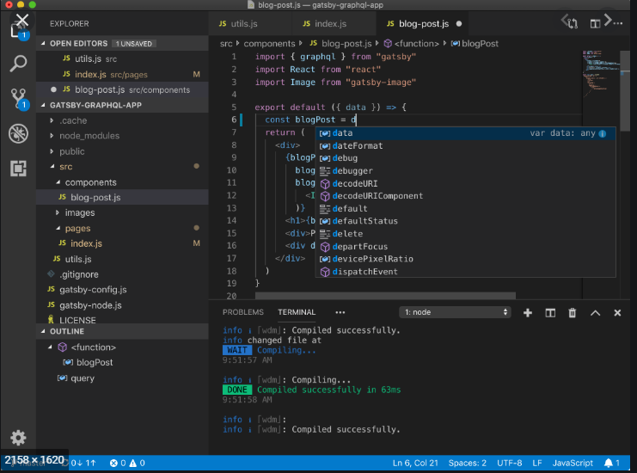
Install VS code in Windows 10
Step 1: Download the latest VS code https://code.visualstudio.com/download
Step 2: Install latest VS code in Windows 10
Visual Studio Code is a free source-code editor made by Microsoft for Windows, Linux and macOS. Features include support for debugging, syntax highlighting, intelligent code completion, snippets, code refactoring, and embedded Git.

Slide 11
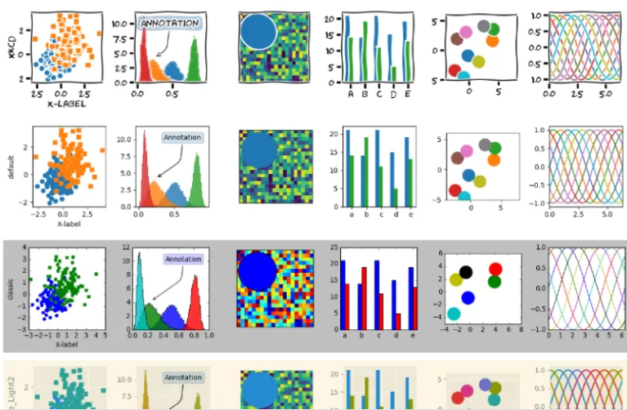
Install matplotlib
pip3 install –user matplotlib
pip install matplotlib==3.0.3 (use this one)
Matplotlib is a plotting library for the Python programming language and its numerical mathematics extension NumPy. It provides an object-oriented API for embedding plots into applications using general-purpose GUI toolkits like Tkinter, wxPython, Qt, or GTK+.
Source: https://www.gnuband.org/2017/12/29/gallery-of-xkcd-and-other-python-matplotlib-styles/

Slide 12
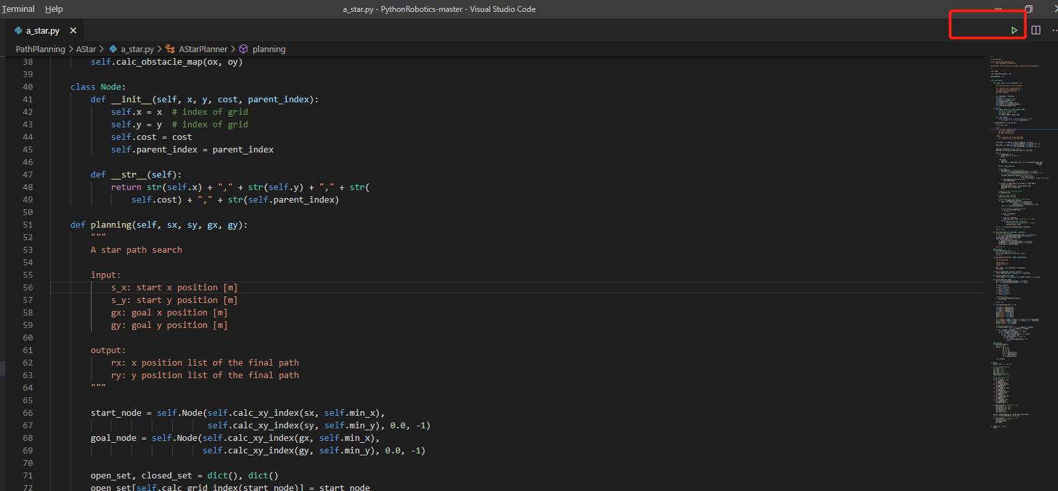
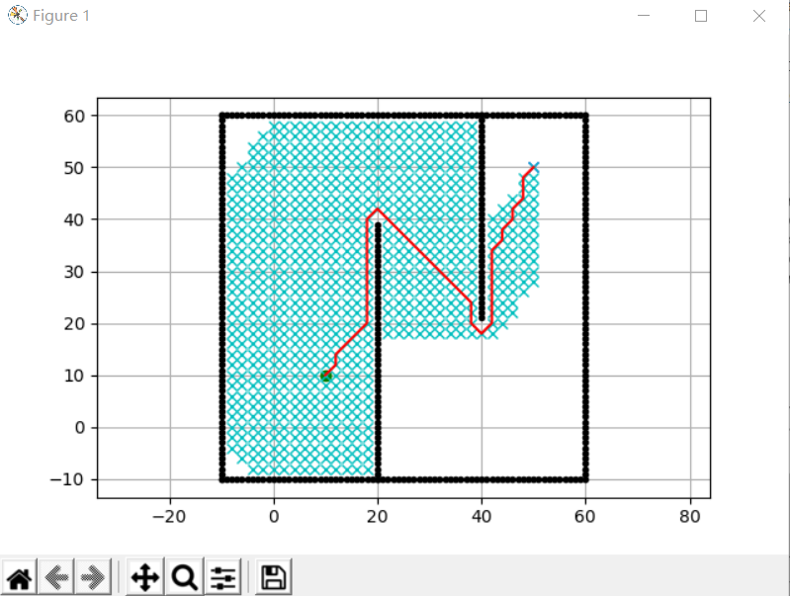
Run A Star in VS code
Run the code
A* is a graph traversal and path search algorithm, which is often used in many fields of computer science due to its completeness, optimality, and optimal efficiency. One major practical drawback is its space complexity, as it stores all generated nodes in memory.

Slide 13
Python
What is Python?
Python is a popular programming language. It was created by Guido van Rossum, and released in 1991.
It is used for:
web development (server-side),
software development,
mathematics,
system scripting.
What can Python do?
Python can be used on a server to create web applications.
Python can be used alongside software to create workflows.
Python can connect to database systems. It can also read and modify files.
Python can be used to handle big data and perform complex mathematics.
Python can be used for rapid prototyping, or for production-ready software development.
https://www.w3schools.com/python/python_intro.asp

Slide 14
Usages of Python
Check you Python Version?
python --version
print:
print("Hello, World!")
Define variable
a=1
b=“hello world”
Print(a)
Print(b)
https://www.w3schools.com/python/python_getstarted.asp

Slide 15
Usages of Python
if function
if 5 > 2:
print("Five is greater than two!")
print("Hello, World!")
Syntax Error if you neglect the indentation
if 5 > 2:
print("F
Syntax Error if you add additional the indentation
if 5 > 2:
print("Five is greater than two!")
print("Five is greater than two!")
https://www.w3schools.com/python/python_getstarted.asp

Slide 16
Python comments
Single line comments
#This is a comment
print("Hello, World!")
multiple lines comments
"""
This is a comment
written in
more than just one line
"""
print("Hello, World!")
https://www.w3schools.com/python/python_getstarted.asp

Slide 17
Python comments
Single line comments
#This is a comment
print("Hello, World!")
multiple lines comments
"""
This is a comment
written in
more than just one line
"""
print("Hello, World!")
https://www.w3schools.com/python/python_getstarted.asp

Slide 18
Python functions
Definitions of functions
A function is a block of code which only runs when it is called. You can pass data, known as parameters, into a function. A function can return data as a result.
Creating a Function
In Python a function is defined using the def keyword:
def my_function():
print("Hello from a function")
https://www.w3schools.com/python/python_getstarted.asp

Slide 19
Python functions
Call functions
To call a function, use the function name followed by parenthesis:
Example
In Python a function is defined using the def keyword:
def my_function():
print("Hello from a function")
my_function()
To learn more interesting usage of python, we suggest to refer to the following link:
https://www.w3schools.com/python/python_variables.asp
https://www.w3schools.com/python/python_getstarted.asp

